Slide 1

Enigma Cipher
Swapnil Paliwal (sp3911)
Arun ram mohan (amr2356)

Slide 2
Index
Enigma
Facts
Our Approach-Cryptanalysis
Analysis
Design
Encryption

Slide 3
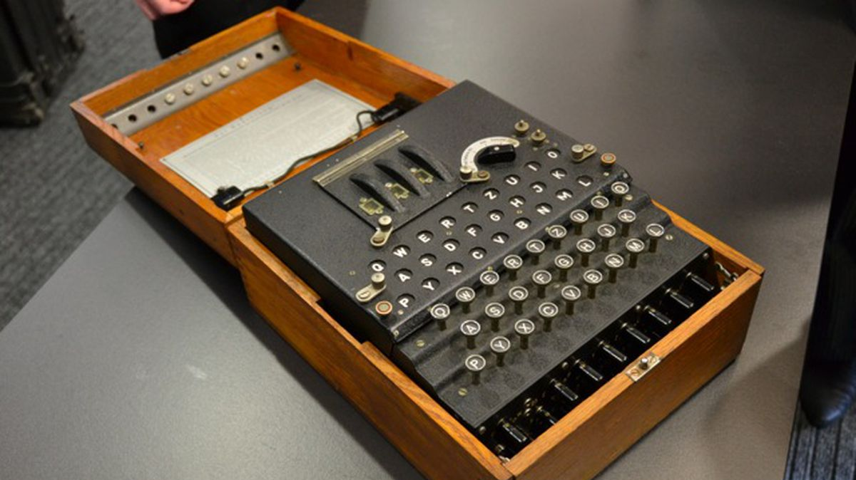
Enigma

Slide 4
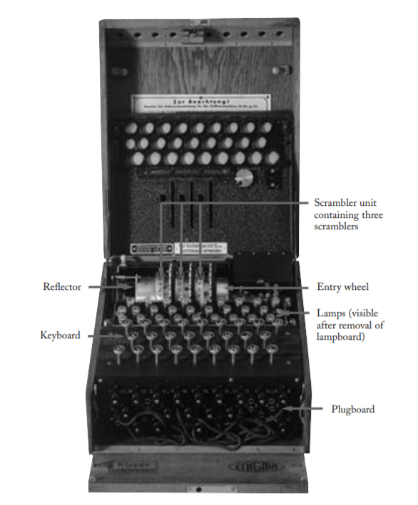
Enigma
The machine Arthur Scherbius built was 13.5 ✕ 11 ✕ 6 inches, but it weighed a hefty 26 pounds.

Slide 5
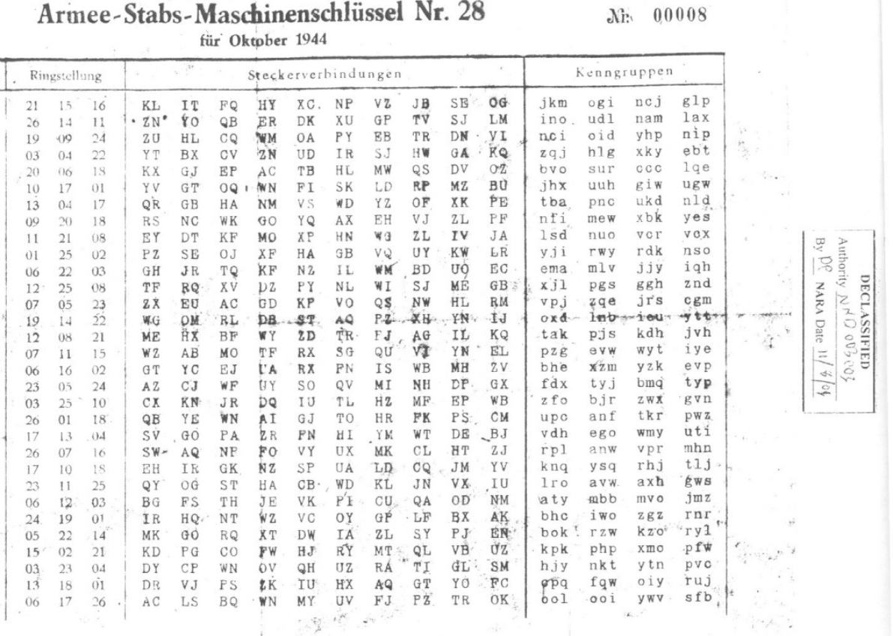
Enigma
How daily settings were communicated

Slide 6
Facts
Under a very unrealistic assumption: We assume that computer tests 20 million Enigma keys/s; each key check consumes 100 cycles on a 2.4 GHz processor.
Breaking Enigma would require: 2.5e+5 years to obtain one correct setting.
Complexity of Enigma: 2^77
Complexity of Data Encryption Standard (DES): 2^56
≈10,000,000,000,000,000 = 17,576 * 6 * 100,391,791,500

Slide 7

Encryption

Slide 8
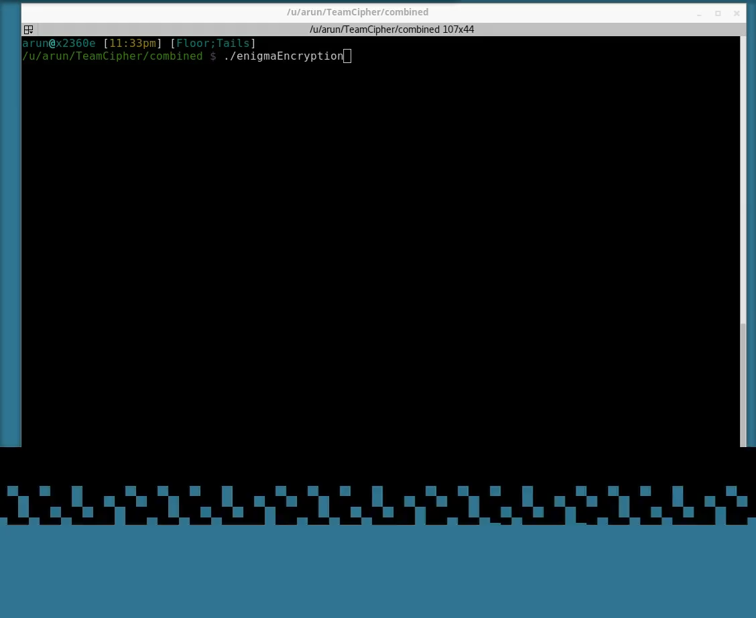
Encryption – Example (Video)
We encrypt 4094 A’s and depict the output to prove correctness of the code.
If the implementation is correct none of the input “A” must yield an “A” in the ciphertext.

Slide 9
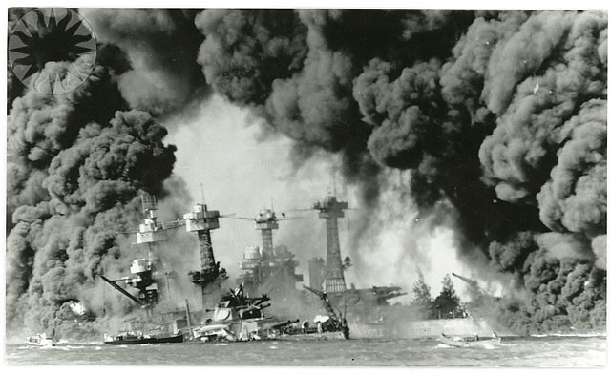
Our Approach - Cryptanalysis
Novel approach to beat the cipher

Slide 10
Our Approach
Sequence
Generate 4-character sequence analysis
Commercial Enigma
Deploy ciphertext-only attack by guessing rotor and ring settings
Known-plaintext
Assume that one plaintext-ciphertext pair is known
Military Enigma Step – I
Find the Rotor and Ring settings using known-plaintext approach
Military Enigma Step – II
Find plugboard settings using the rotor and ring settings
Military Enigma Step – III
Combine the results

Slide 11
Our approach – Commercial Enigma
We are using ciphertext-only attack, which is an attack where we have information only about the ciphertext and the algorithm used.
We borrow a scoring function of quadgram analysis. Using which we score a key.
Quadgram Example: SWAPNIL -> SWAP WAPN APNI PNIL
Step 1: Start with an arbitrary key.
Step 2: Decrypt the message and obtain a base score
Step 3: Guess another key
Step 4: Decrypt the message and obtain the score. Compare with the previous score. If score is better, we accept this as the new key.
Step 5: Repeat steps 3 and 4.

Slide 12
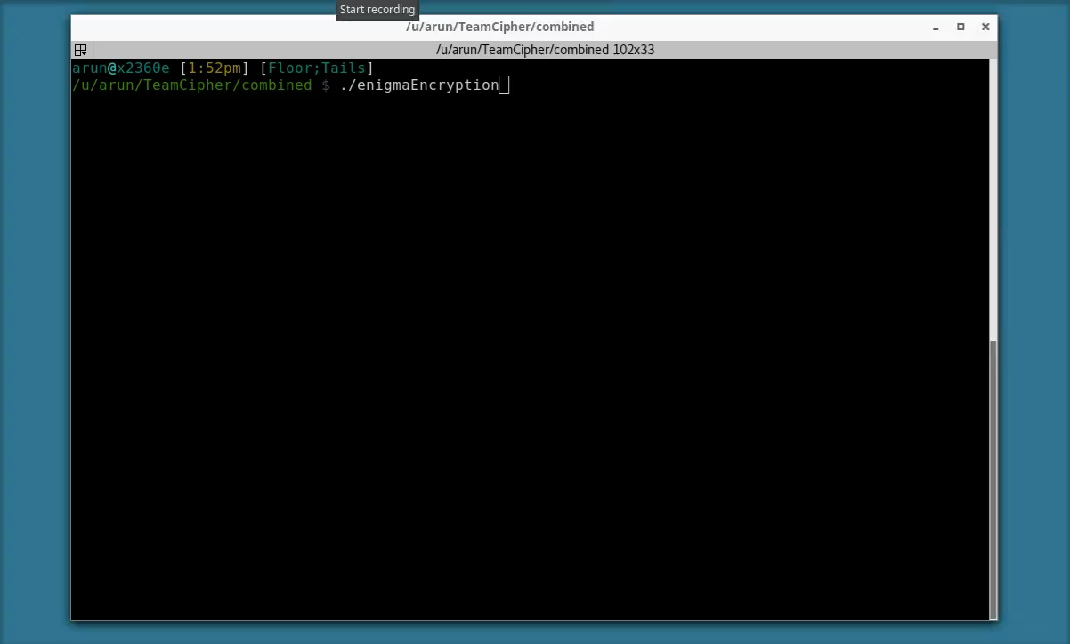
Cryptanalysis – Example (Video)
Using the above algorithm to test the effectiveness of the cryptanalysis function.

Slide 13

Known-plaintext attack
The known-plaintext attack (KPA) is an attack model for cryptanalysis where the attacker has access to both the plaintext (called a crib), and its encrypted version (ciphertext).

Slide 14
Our Approach – Military Enigma
We are using known-plaintext attack, which is an attack where we have information about the ciphertext, and plaintext pair and the algorithm used. However, it must be infeasible to derive the settings because of total possible combinations.
Total number of plugboard settings when there are 10 plugs is 150,738,274,937,250.
Modified scoring function: Number of matching plaintext characters.
Step 1: Start with an arbitrary key.
Step 2: Decrypt the message and obtain a base score (Number of plaintext character and ciphertext character match at same location).
Step 3: Guess another key.
Step 4: Decrypt the message and obtain the score. Compare with the previous score. If score is better, we accept this as the new key.
Step 5: Repeat steps 3 and 4.
Step 6: Create a plug Q->W, Q->E,…Q->M; W->E, W->R,…W->M;… and decrypt using the individual intact to the machine

Slide 15

Our Approach – Watch out
Rotor Settings: SIG
Ring Settings: PMP
Message: KMMSJAGUARISTAUFPUNKTISDIRECTEDTOFIFTYTHREEDEGREESTWENTYFOURMINUTESNORTHANDAUFPUNKTONEDEGREEWESTHEILHITLER
Ciphertext: VYUFEPVPWJBBKNOOGYHYXWGGSFFGPCENFSBMDZFSERQRZIJIQCWJFGPEWJZNYYSHIQGHUFLOWYWEFDVOWNWKYSVAXMNXHHVBQGZORQQKLH

Slide 16
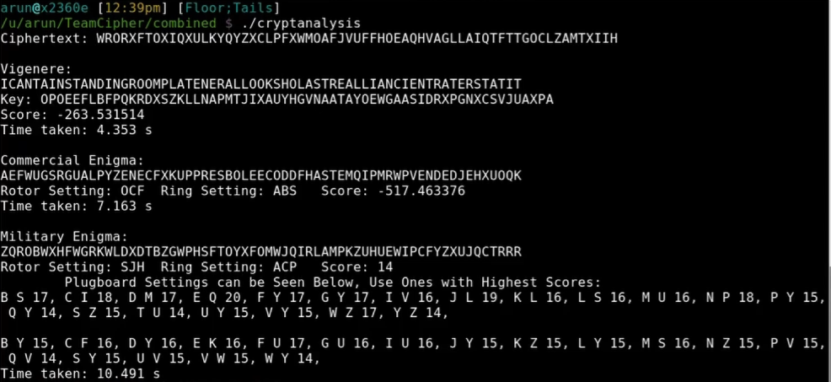
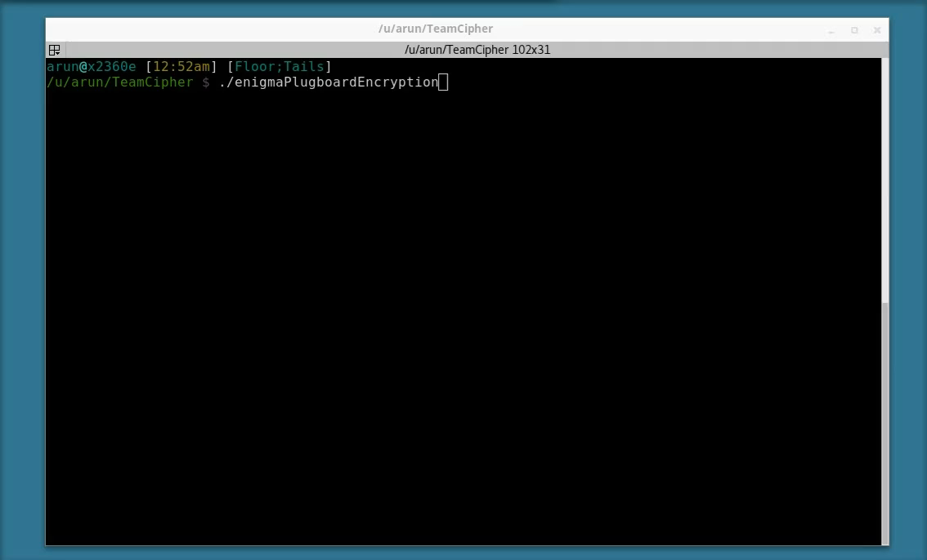
Cryptanalysis – Compare
Actual ciphertext: VYUFEPVPWJBBKNOOGYHYXWGGSFFGPCENFSBMDZFSERQRZIJIQCWJFGPEWJZNYYSHIQGHUFLOWYWEFDVOWNWKYSVAXMNXHHVBQGZORQQKLH

Slide 17

Analysis
Known-plaintext attack is much more efficient than the scoring function based on 4-character sequence analysis.

Slide 18
Analysis – Commercial
Length of ciphertext | Average execution time (s)
65 | 12.97
100 | 15.29
150 | 22.36
200 | 32.49
250 | 40.16
300 | 45.11
10 samples for each length

Slide 19
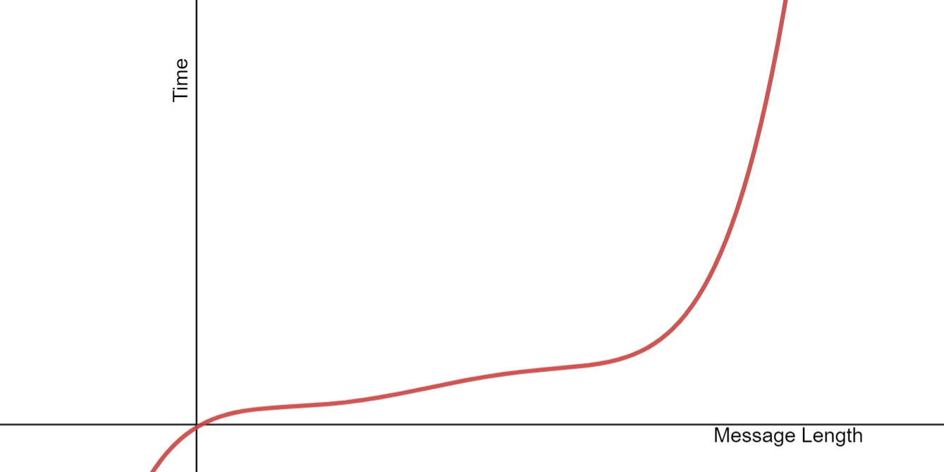
Time versus length - Commercial
Exponential growth as length increases

Slide 20
Analysis – Military
Length of ciphertext | Average execution time (s)
65 | 10.47
100 | 18.22
150 | 20.15
200 | 24.62
250 | 41.39
300 | 42.72
10 samples for each length

Slide 21
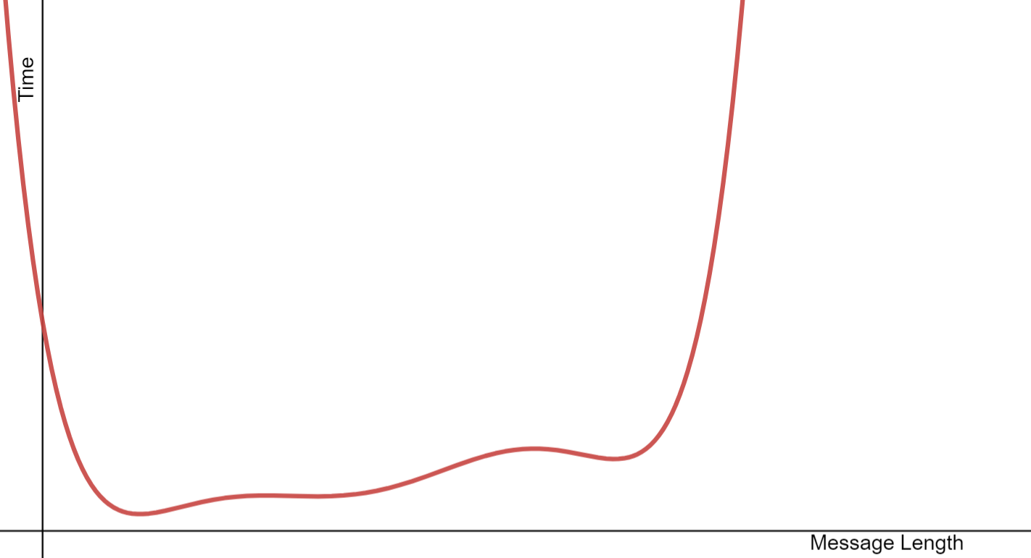
Time versus length – Military
Exponential growth as length increases

